Slide 1
Internship 2022
Progress report format
for Flight Control team
Name: kariuki robert mukono

Slide 2
Tasks completed last week
~ Preparations were made for the test flight.
~ Most of the time has been spent trying to familiarize ourselves further and further with the current code, following the directive to effectively ensure zero roll – for the sake of its modification and improvement.

Slide 3
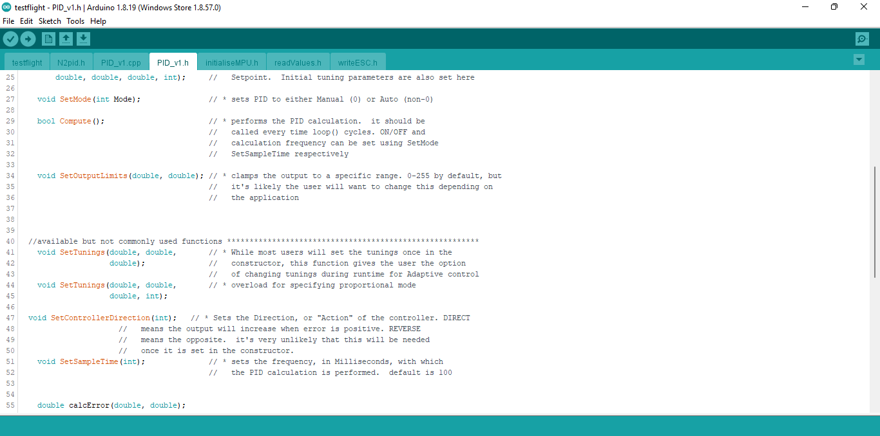
Example of code being studied

Slide 4
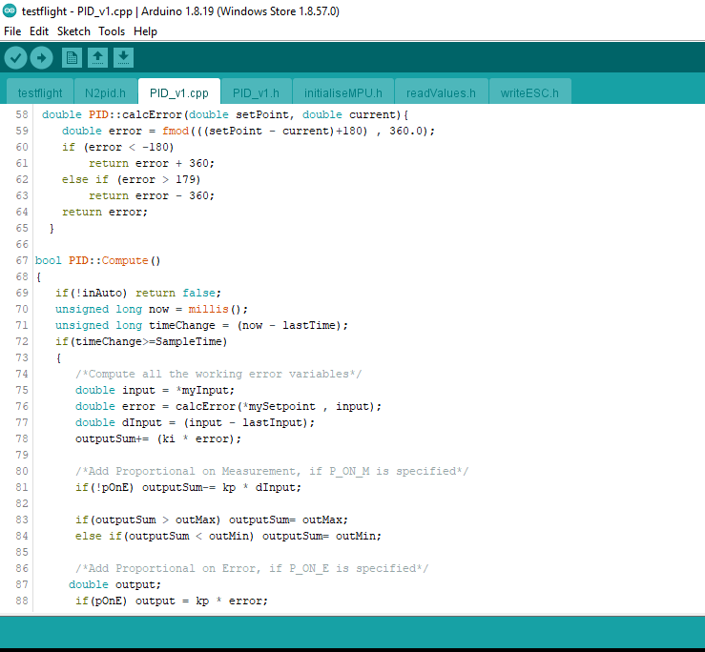

Slide 5
Tasks in this week
~ This week we purpose to finish studying the code.
~ We also purpose to begin refining the current code.
~ We also purpose to do preliminary tests to test the effectiveness of the code.

